Slide 1
Measuring and Improving Native
Execution in Apache DataFusion Comet

Slide 2

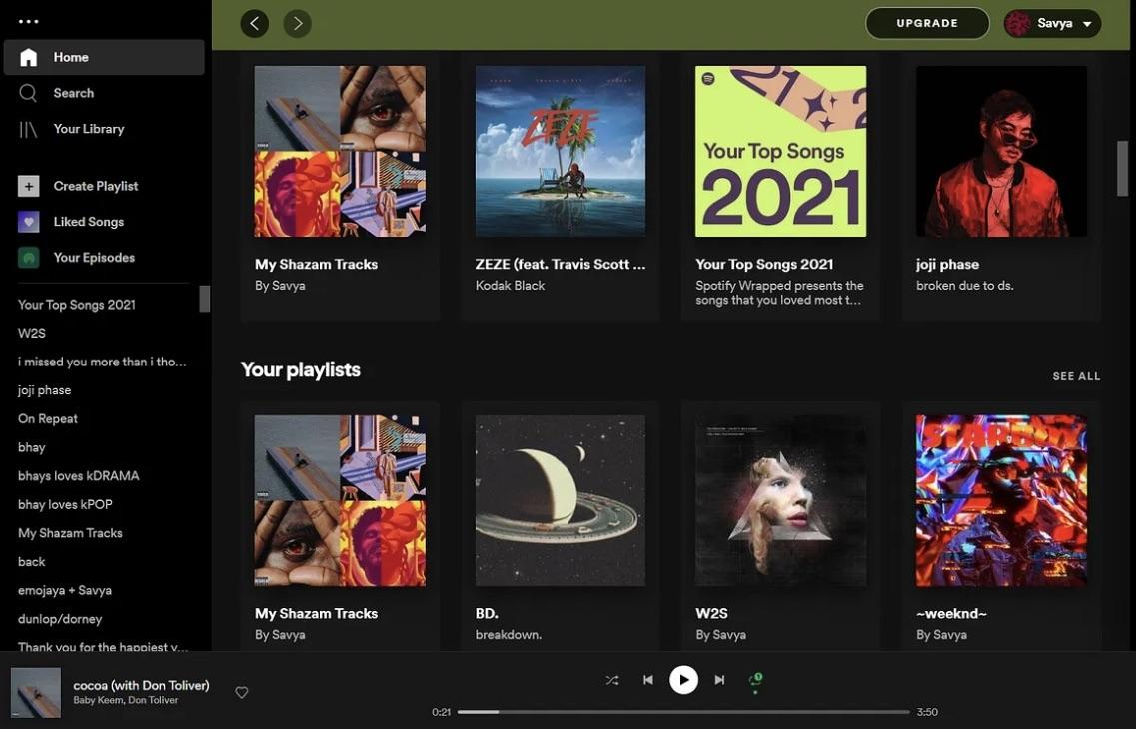
“DATA IS THE NEW OIL IN 21st CENTURY!”

Slide 3
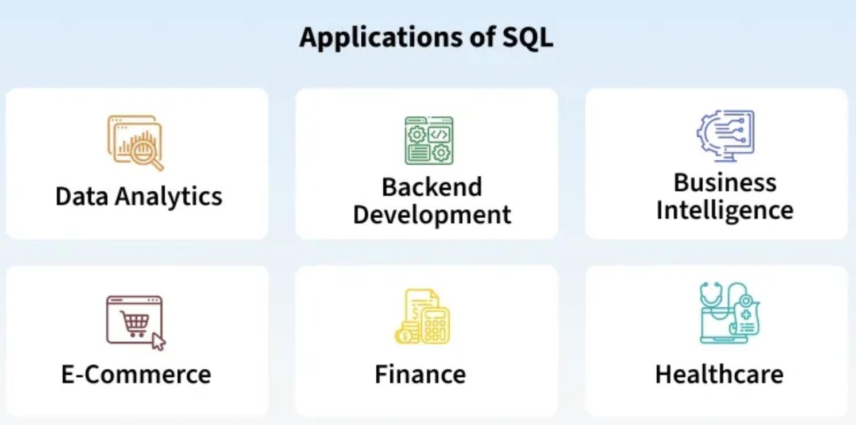
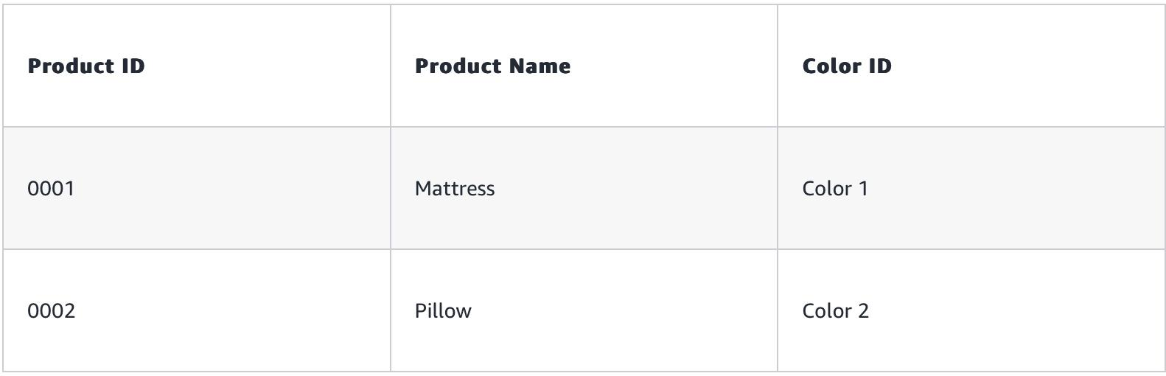
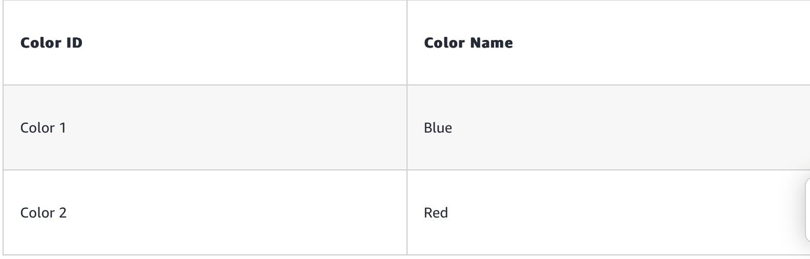
A database is an organized collection of structured information, or data, typically stored electronically in a computer system.
A database is typically deployed and accessed via cloud environment.
SQL is a programming language used to interact with the database.
TABLE-1
TABLE-2

Slide 4
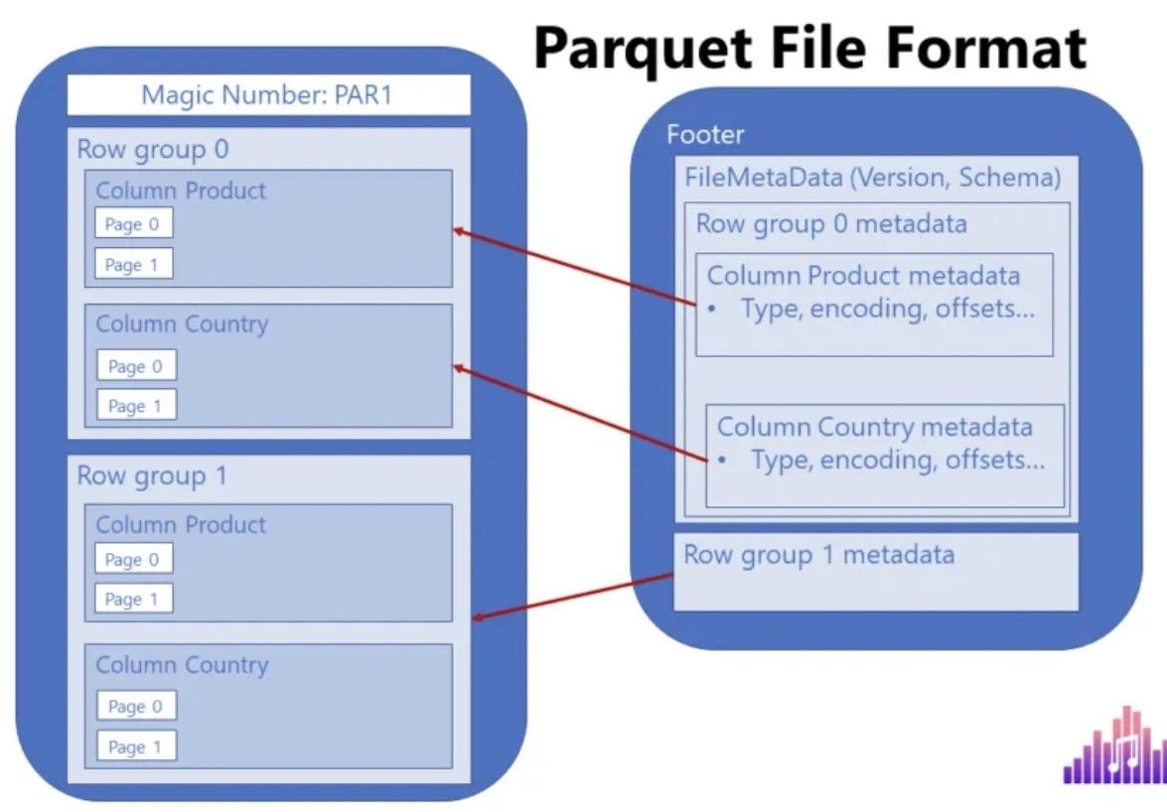
Traditional Row based storage is very slow and memory inefficient.
Parquet files store chunks of data in row-groups as well as metadata.
The row-group format offers for more efficient memory usage through dictionary encoding.

Slide 5
Apache Spark
Apache Spark is an open-source, distributed processing system used for big data workloads.
Spark uses in-memory processing for its intermediate steps and also utilises caching to reduce physical disk I/O latency.
It is 100 TIMES FASTER than Hadoop MapReduce!

Slide 6
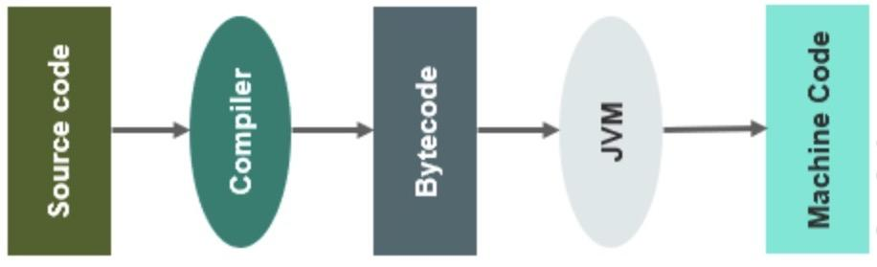
The disadvantage of Spark is that it executes query operators as JVM Bytecode
The query engine compiles the block of code to generate a Bytecode for each method
Bytecode bundles all code application into a single .JAR file

Slide 7
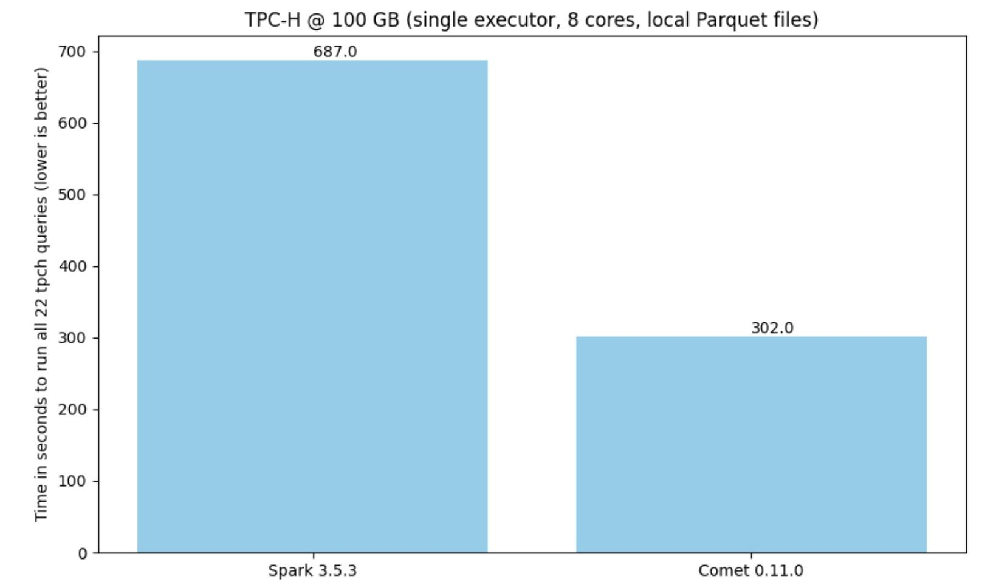
DataFusion Comet
Comet replaces JVM-Bytecode with native Rust.
Native rust eliminates the overhead of Garbage Collector and also reduces the SIMD clock cycles.
Comet also utilizes the Arrow columnar data format which is faster because of vector processing.

Slide 8
Yet, as of today, not all the query operators run natively in Comet and instead fall back to Spark.
Our job is to investigate which physical operators and expressions execute natively vs fall back to the JVM
This is done by computing the coverage metrics over benchmark workloads (TPC-H, TPC-DS)

Slide 9
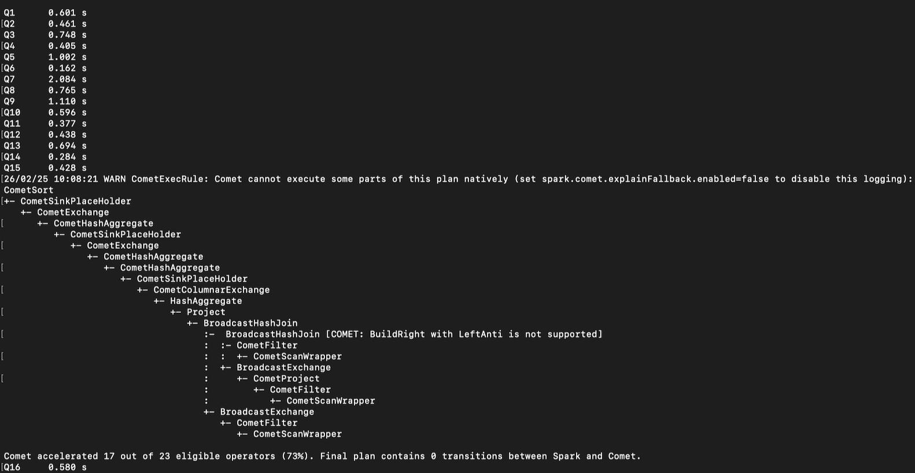
TPC-H Results

Slide 10
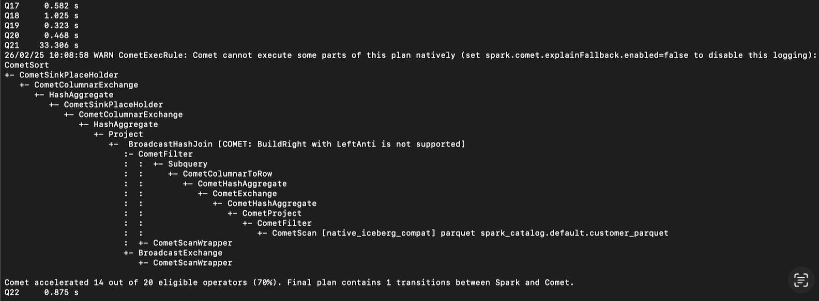
What’s up with the super high latency of Q21??

Slide 11
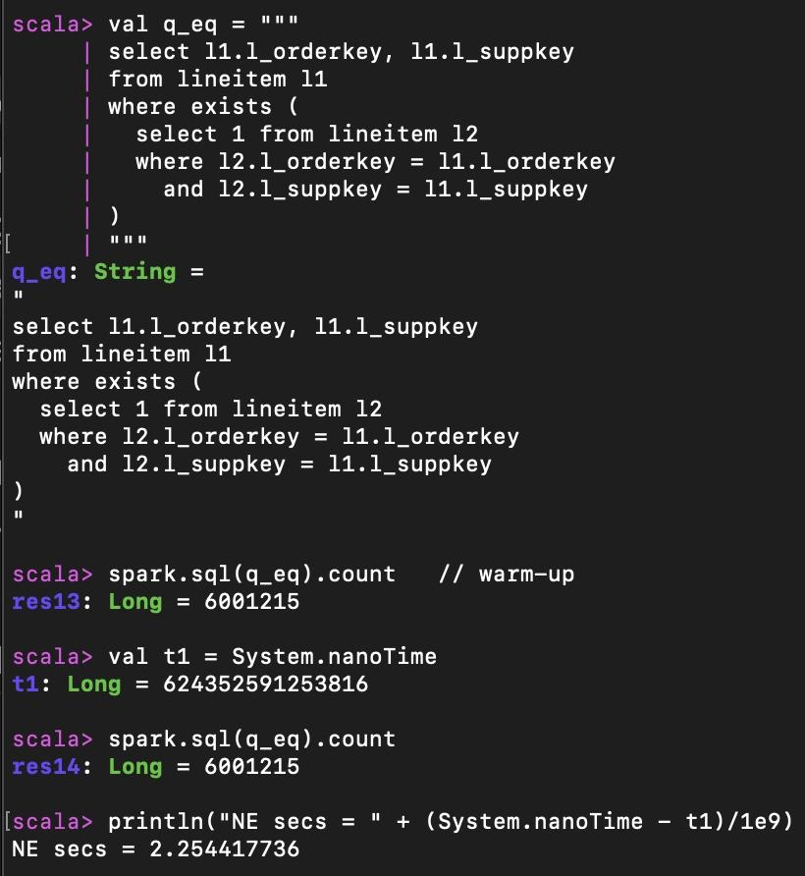
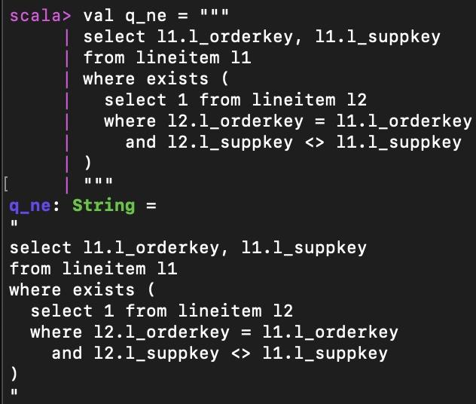
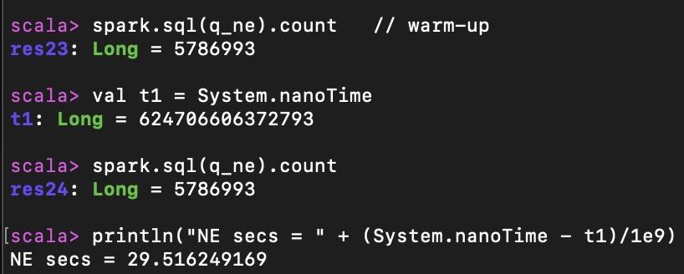
The Left Semi Join operator with inequality is the issue

Slide 12
TPC-DS Results
TPC-DS is a much larger benchmark and it consists of 99 Queries in total, which is 4.5 times more than the queries in the TPC-H.
Nearly 40 queries fall back to JVM out of the total of 99
The most common Fallback reasons are:
(1) Unsupported Join types
(2) Unsupported Aggregation Modes
(3) Unsupported Window Functions

Slide 13
Next Steps
Identify overhead bottlenecks in TPC-DS w.r.t Joins, Aggregates and Window Functions
Propose concrete optimization targets for both the TPC-H & TPC-DS
Implement performance improvements and feature extensions
Finally benchmark the before vs after performance of operator performance w.r.t time taken and the native coverage.

Slide 14
Quiz Question
Why/How does DataFusion Comet accelerate Spark SQL?
(A): By executing query operators natively in JVM
(B): By executing query operators natively in Rust outside the JVM
(C): By rewriting all SQL queries as stored procedures
(D): By caching all the data in JVM heap memory
(E) By compressing data before sending it to the JVM

Slide 15
Image & Content References
slide-3
https://www.oracle.com/database/what-is-database/
https://www.geeksforgeeks.org/sql/what-is-sql/
https://aws.amazon.com/what-is/sql/
slide-4
https://datamozart.substack.com/p/parquet-file-format-everything-you
slide-5
https://aws.amazon.com/what-is/apache-spark/
slide-6
https://www.edureka.co/blog/java-bytecode/
slide-7
https://datafusion.apache.org/comet/

